Slide 1
PIXEL PORTFOLIO
STUDENT NAME: S.M.NAFIYA
REGISTER NO AND NMID: 31224U48032 and 2EBEE8B01B3AB9C91A644983D3A783D1
DEPARTMENT:B.SC.DATA SCIENCE
COLLEGE COLLEGE/UNIVERSITY: ISLAMIAH WOMEN’S ARTS AND SCIENCE COLLEGE, THIRUVALLUVAR UNIVERSITY

Slide 2
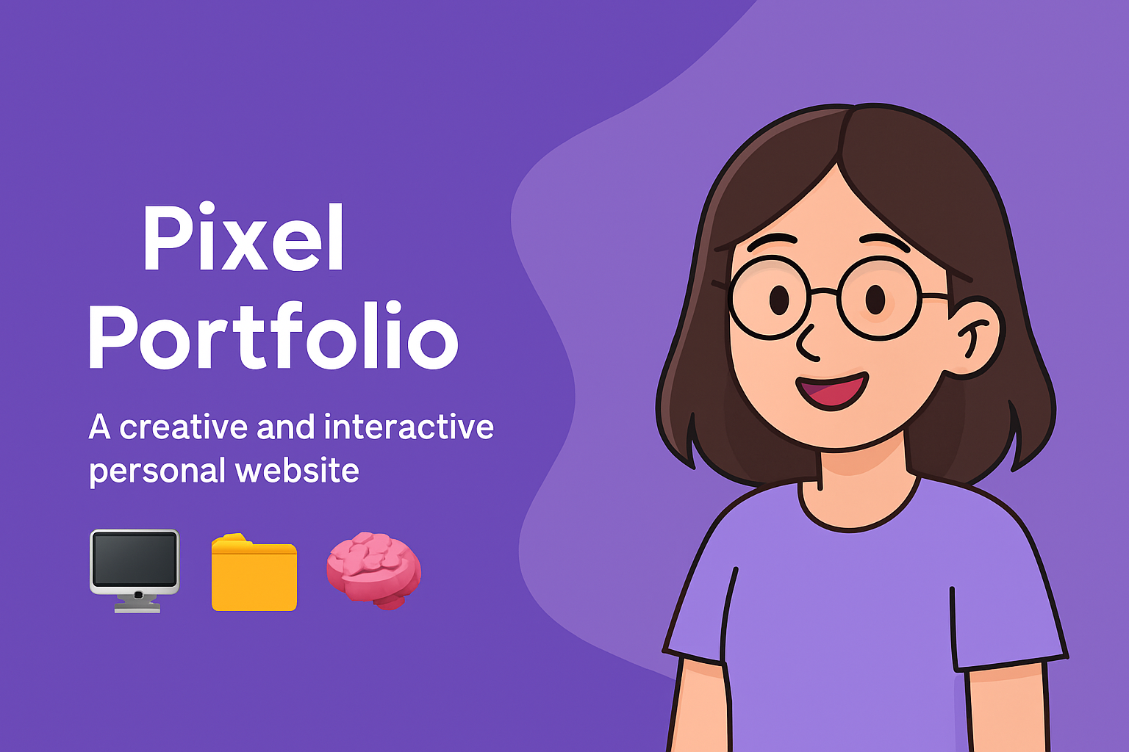
🖼️ PROJECT TITLE
Title: PIXEL PORTFOLIO
Description: A creative and interactive portfolio website built using HTML, CSS, and JavaScript.
Features: Includes personal info, projects, and skills.

Slide 3
AGENDA
1️⃣ Problem Statement 2️⃣ Project Overview 3️⃣ End Users 4️⃣ Tools and Technologies 5️⃣ Portfolio Design and Layout 6️⃣ Features and Functionality 7️⃣ Results and Screenshots 8️⃣ Conclusion 9️⃣ GitHub Link

Slide 4
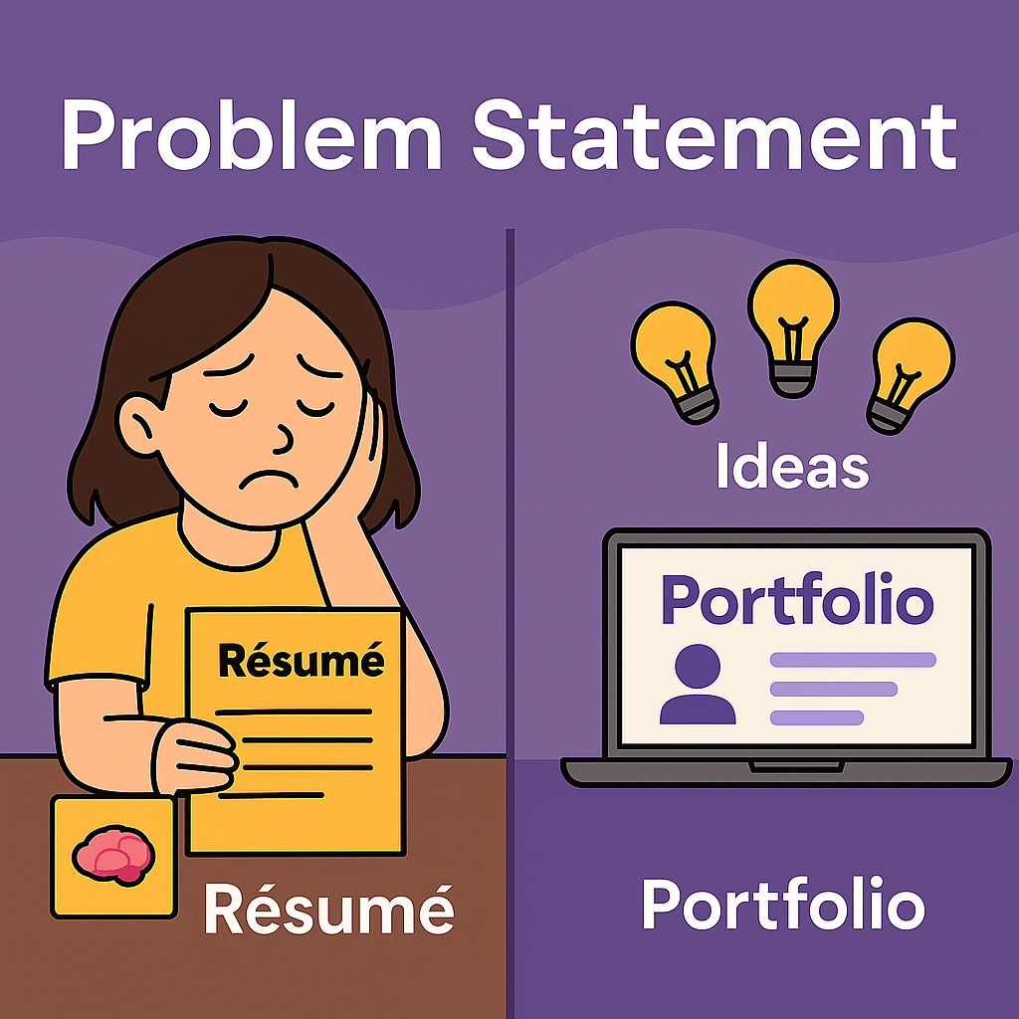
💡PROBLEM STATEMENT
Challenges:
Resumes and paper documents aren’t enough in today’s competitive world. Students/job seekers struggle to present skills effectively. Employers prefer digital portfolios that show creativity and technical skill.
Solution :A customizable, user-friendly portfolio website.

Slide 5
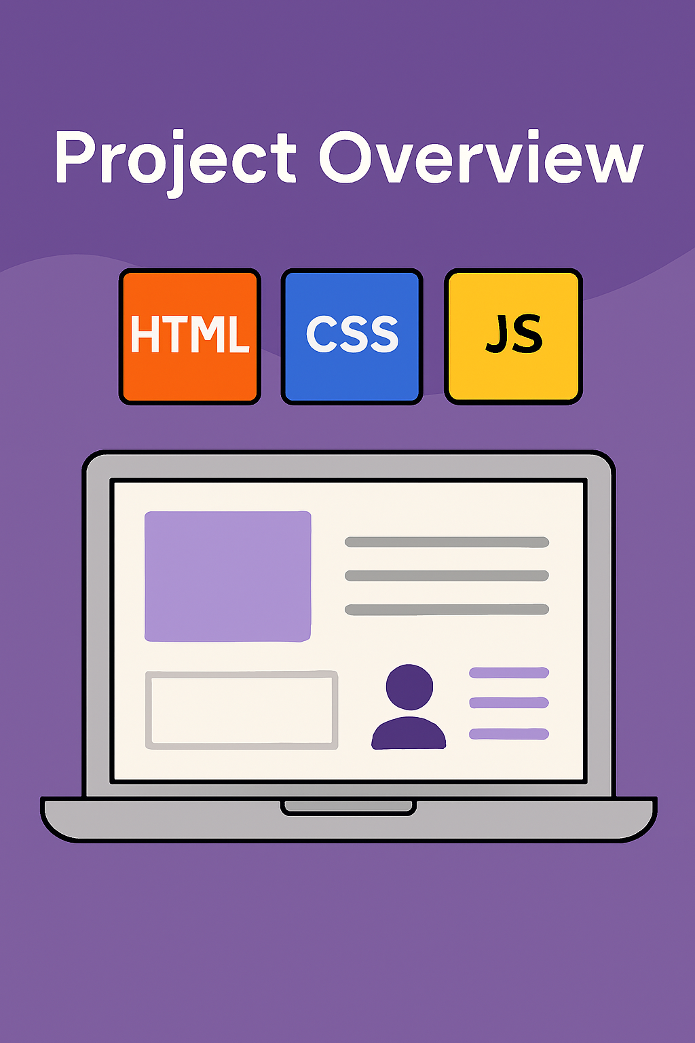
🧭 PROJECT OVERVIEW
Purpose: Showcase background, skills, and projects Tech stack: HTML, CSS, JavaScript Focus: Responsiveness and user experience Goal: Build a professional digital presence

Slide 6

🎯END USERS
TARGET AUDIENCE
Students: Share academic work and skills. Job seekers: present portfolios to recruiters. Freelancers : Display services and testimonials.
General visitors : Learn more about the individual.

Slide 7
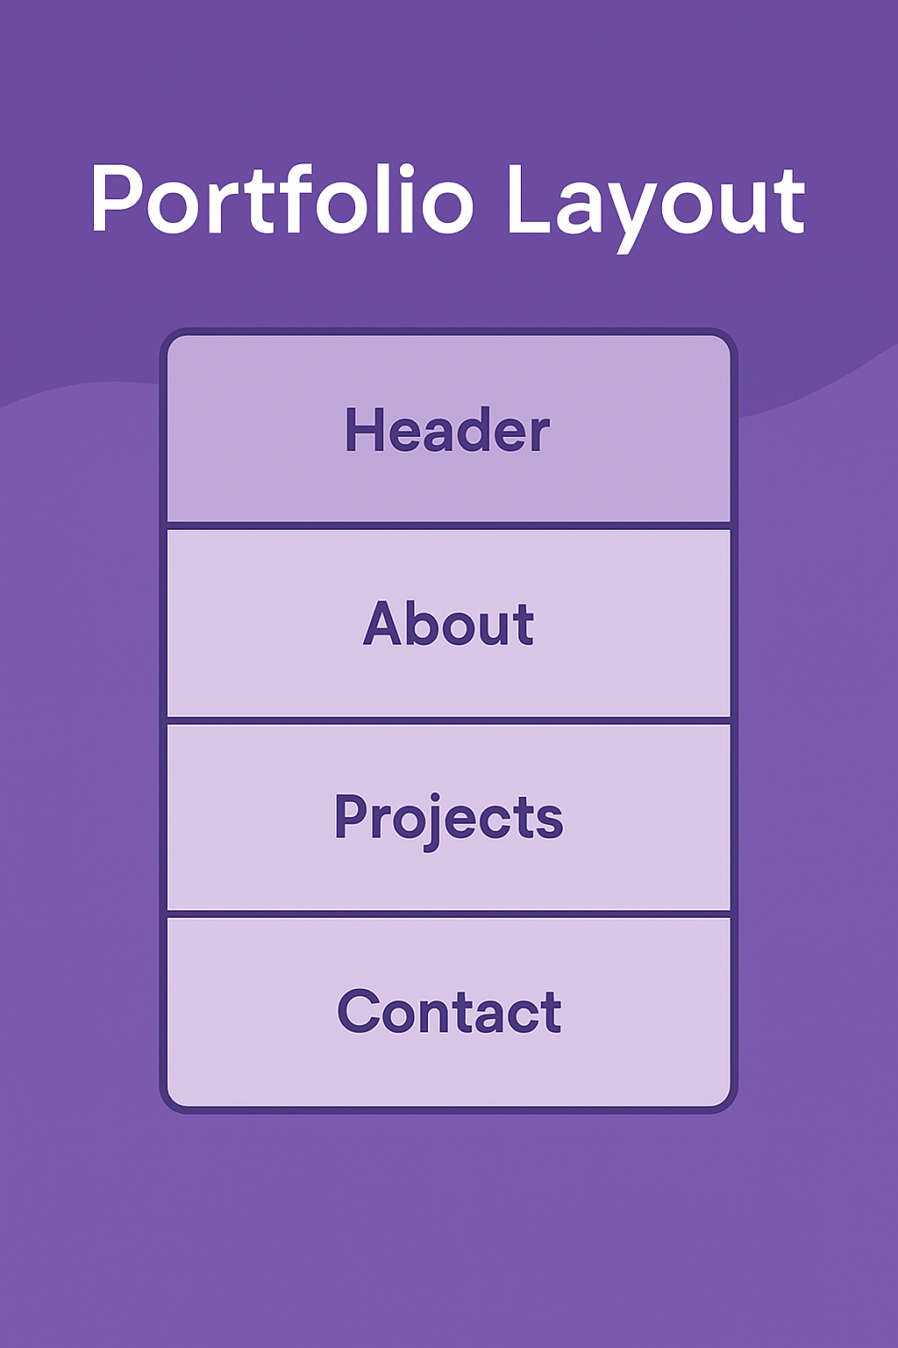
🛠️TOOLS AND TECHNOLOGIES
Core Tools:
HTML: Structure
CSS: Styling
JavaScript: Interactivity
Future Enhancement :
Bootstrap
React.js
Node.js

Slide 8
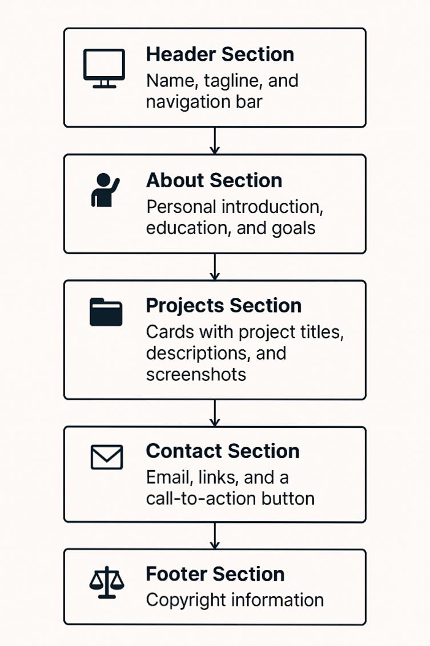
🧩 PORTFOLIO DESIGN AND LAYOUT
🖥️ Header Section → Name, tagline, and navigation bar. 🙋 About Section → Personal introduction, education, and goals. 📂 Projects Section → Cards with project titles, descriptions, and screenshots. 📧 Contact Section → Email, links, and a call-to-action button. ⚖️ Footer Section → Copyright information.

Slide 9
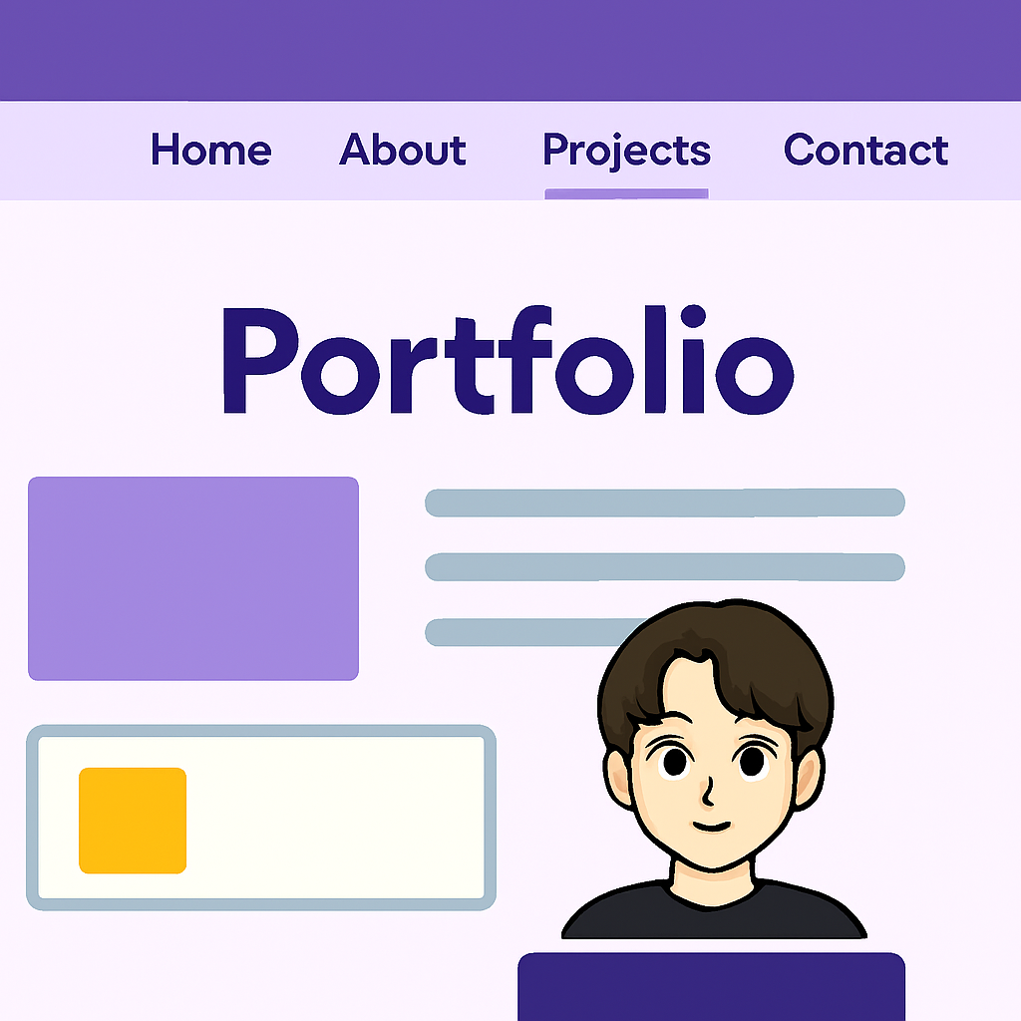
⚙️ FEATURES AND FUNCTIONALITY
Design: Clean, responsive
Navigation: Smooth scrolling Contact: JavaScript alert buttons Flexibility: Easy to update

Slide 10
📸 RESULTS AND SCREENSHOTS
Outcomes:
🎯 Successfully developed a fully functional site. 🎓 Demonstrates frontend skills 🌟 Created a pixel portfolio that reflects personal identity and skills. 📸 Screenshots to add in PPT:
🙂‍↕️ Header 🏠 Homepage/ intro 🙋 About Section 📂 Projects Section 📧 Skill and Contact Section
🦶🏻 Footer

Slide 11
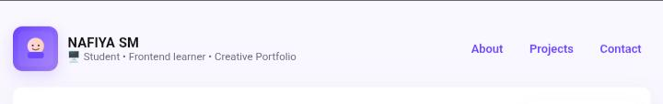
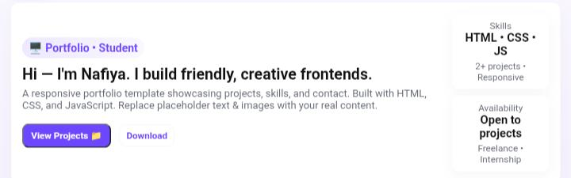
SCREENSHOTS
Header
Homepage/intro

Slide 12
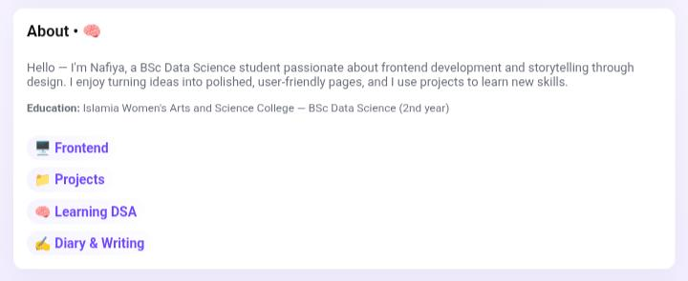
About Section

Slide 13
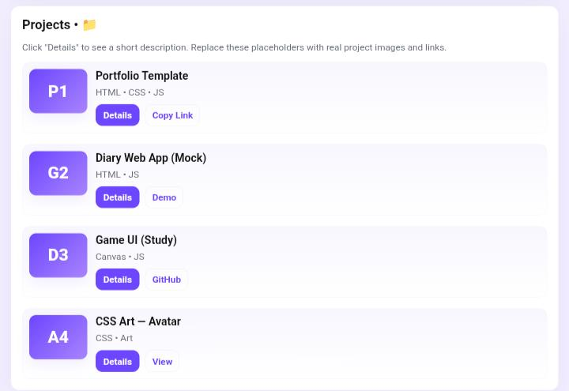
Project section

Slide 14
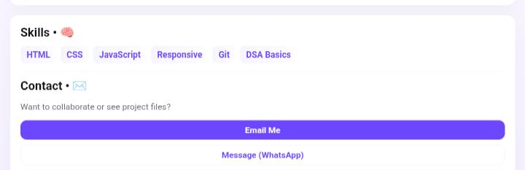
Skills and contact
Footer

Slide 15
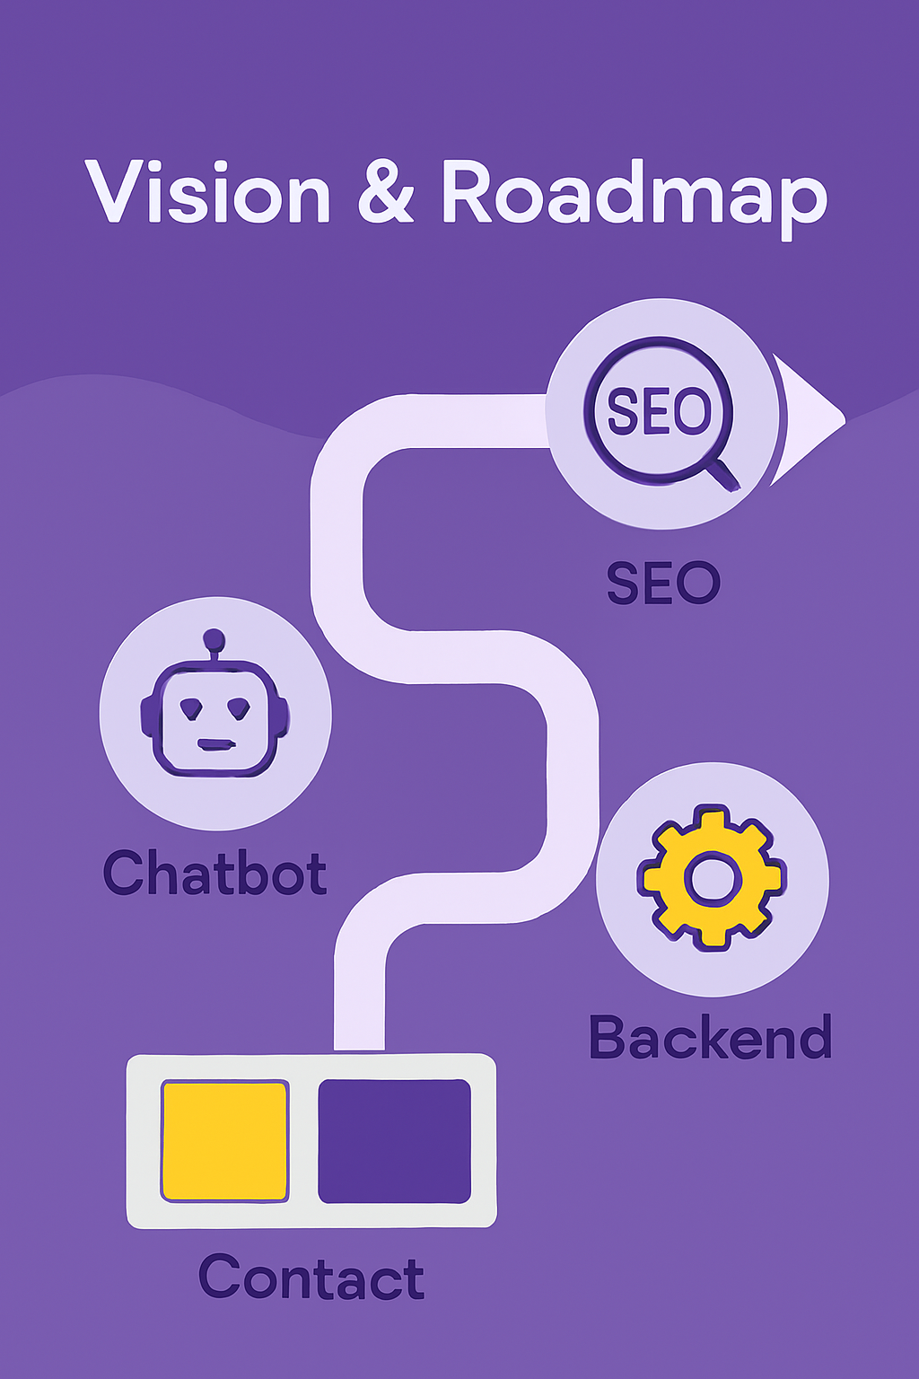
🏁 CONCLUSION
Learnings: Frontend development, design thinking Impacts : Solves digital identity challenge
Future scope:
Chabot integratio
Backend features
SEO optimization

Slide 16


